Slide 1


MOVILIZATE UN
Grupo 8
Natalia Cely Callejas
Edward Vásquez
Jhohan Contreras
Johan Rodriguez
Felipe Chaves Delgadillo

Slide 2

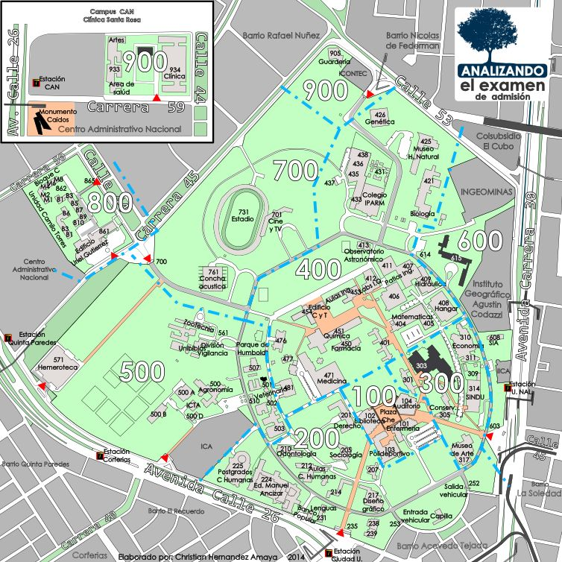

Problema a resolver

Slide 3


Requerimientos funcionales
Historial de viajes
Cálculo de distancias

Slide 4
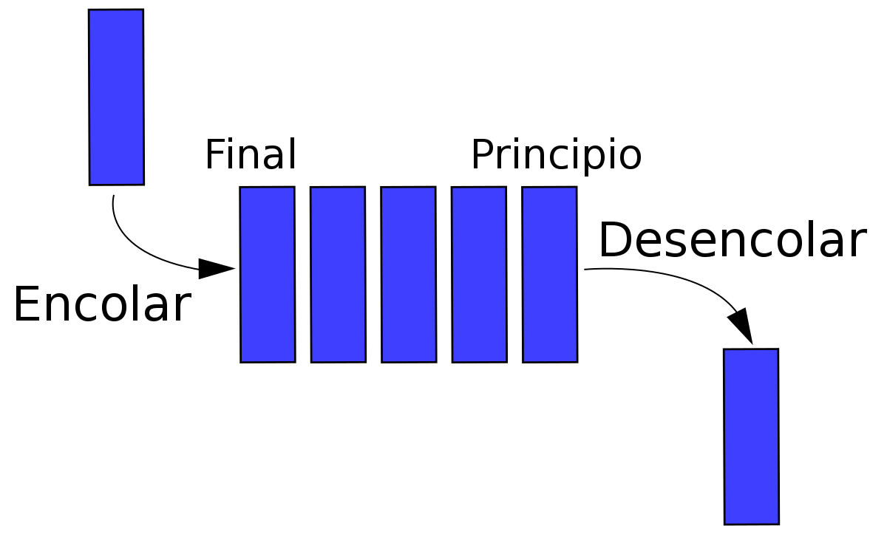
Uso de estructuras de datos en la solución del problema a resolver

Slide 5
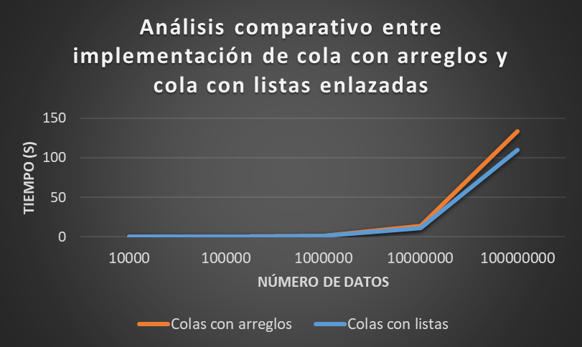
Pruebas y análisis comparativo del uso de las estructuras de datos

Slide 6




Lenguajes de programación y herramientas de software usados

Slide 7
Referencias
https://www.google.com/url?sa=i&url=https%3A%2F%2Fwww.hackaboss.com%2Fblog%2Fque-es-github-y-por-que-es-util-al-aprender-programacion&psig=AOvVaw2y9GbOUfPmj4mhblNCo0WR&ust=1652752823363000&source=images&cd=vfe&ved=0CAwQjRxqFwoTCMD4mZv24vcCFQAAAAAdAAAAABAD
https://www.google.com/url?sa=i&url=https%3A%2F%2Fwww.jetbrains.com%2Fes-es%2Fpycharm%2F&psig=AOvVaw3e2sOskLeuqu7D9uBv05MV&ust=1652752799798000&source=images&cd=vfe&ved=0CAwQjRxqFwoTCPiM1rH24vcCFQAAAAAdAAAAABAD
https://www.google.com/url?sa=i&url=https%3A%2F%2Fes.wikipedia.org%2Fwiki%2FHistoria_de_Python&psig=AOvVaw0mG7aSiGE_huA26E_Wr7CI&ust=1652752776351000&source=images&cd=vfe&ved=0CAwQjRxqFwoTCLCkxLf24vcCFQAAAAAdAAAAABAD
https://www.google.com/url?sa=i&url=http%3A%2F%2Fmarisolinnovacion.blogspot.com%2F2012%2F10%2Fdesorientada.html&psig=AOvVaw0F_FrW5XogrcWfDO70S7In&ust=1652752966093000&source=images&cd=vfe&ved=0CAwQjRxqFwoTCMimmeD24vcCFQAAAAAdAAAAABAD
https://www.google.com/url?sa=i&url=https%3A%2F%2Frepositorio.unal.edu.co%2Fhandle%2Funal%2F75122&psig=AOvVaw3U-pxRezf-ci2E9Vv7ZUxo&ust=1652752928726000&source=images&cd=vfe&ved=0CAwQjRxqFwoTCIi6pO_24vcCFQAAAAAdAAAAABAD
https://www.google.com/url?sa=i&url=https%3A%2F%2Fes.wikipedia.org%2Fwiki%2FCola_(inform%25C3%25A1tica)&psig=AOvVaw3ZepuOJsB1baFwI5UJ_ef2&ust=1652757350603000&source=images&cd=vfe&ved=0CAwQjRxqFwoTCODF6t6I4_cCFQAAAAAdAAAAABAD

